Slide 1
Routing in WebAPI
Sarita Lad
DATE

Slide 2
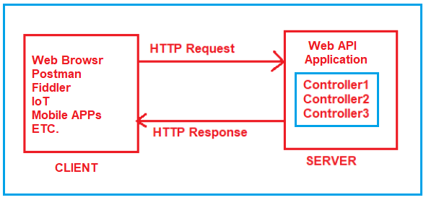
What is Routing in ASP.NET Core?
It is important that we need to understand is, how the application will come to know which request will be mapped to which controller action method. Basically, the mapping between the URL and resource is nothing but the concept or Routing.

Slide 3
For the Routing Concept in ASP.NET Core Web API, we generally set some URLs for each resource. When we run the application, then it will create the Route table and the Route table will contain the mapping information between the URL and the Resource. So, when we are sending a request from the client to the server, then the application will check the URL in the Route table and if it found an exact, then the application will forward the request to that particular resource else it will throw an error saying resource not found.
We can access any resource using a unique URL in ASP.NET Core Web API Application. It is also possible that a resource can have multiple unique URLs. But multiple resources can not have the same URL and if you do so, then the application gets confused to invoke which action method and as a result, you will get an ambiguity error.
So, the ASP.NET Core Framework maps the incoming HTTP Requests i.e. URLs to the action methods of Controllers based on the routes that are configured for your application. In ASP.NET Core, it is also possible to configure multiple routes, and also it is possible to set some specific configurations such as default values, constraints, message handlers, etc

Slide 4
How to enable Routing in ASP.NET Core Web API?
Adding ASP.NET Core Web API Service:
When we create aspnet Core WebAPI – new Project :
Add following Service in IOC container:
public void ConfigureServices(IServiceCollection services)
{
services.AddControllers();
}
we need to add the following two middleware components to the HTTP Request processing Pipeline.
UseRouting(): The UseRouting Middleware only enables the Routing for your application. This will not map any URL to any resource.
UseEndpoints(): This middleware will map the URL to the resource. But the most important point that you need to remember is, the action methods are not only the resource that you can map. You can also map static file resources to a URL. But here we are only focusing on ASP.NET Core Web API and hence we are going to map the URL to action methods.

Slide 5
Configuring the Routing Middlewares in ASP.NET Core:
if we want to configure any middleware then we need to configure the same inside the Configure method of the Startup class. So, let us modify the Configure method of the Startup class as shown below to configure the UseRouting and UseEndpoints Middlewares which will enable Routing as well as the mapping between the URL and Resource. As you can see in the below code within the UseEndpoints Middleware we write MapControllers which will actually set the mapping between URL and Controller action method. So, the Map controller will act as a bridge between the HTTP Request and the Controllers.
public void Configure(IApplicationBuilder app, IWebHostEnvironment env)
{
if (env.IsDevelopment())
{
app.UseDeveloperExceptionPage();
}
app.UseRouting();
app.UseEndpoints(endpoints =>
{
endpoints.MapControllers();
}); }

Slide 6
In ASP.NET Core Application, we have two ways to define the Routing i.e. Conventional Based and Attribute-Based Routing. And Attribute Routing is the most preferred way of defining routes in ASP.NET Core Web API Application and hence, we are only going to focus on Attribute Routing in this course.
[Route("api/[controller]")]
[ApiController]
public class EmployeeController : ControllerBase
{
}
Using the Route Attribute, we can define the Routes in ASP.NET Core Application either at the Controller level or at the action method level. Before using the Route Attribute lets us have a look at the signature of the Route Attribute. The following image shows the definition of the Route Attribute.

Slide 7
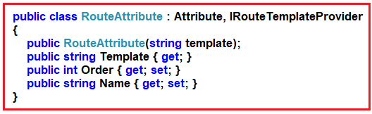
As you can see in the above image, Route Attribute is basically a class inherited from the Attribute class and IRouteTemplateProvider interface. The Constructor of the RouteAttribute class takes the template as an input parameter which is nothing but the URL that you are excepting from the client and it cannot be null.

Slide 8
Adding Attribute Routing in ASP.NET Core Web Application:
Now let us add two action methods within the EmployeeController class. Now, don’t concentrate on the return type and the data that we are returning from the action method, rather concentrate on the Routing concept. We want to invoke the GetAllEmployees method with the URL /Emp/All and GetEmployeeById method with the URL /Emp/ById. To achieve this, we can use the Route Attribute and decorate the action GetAllEmployees and GetEmployeeById method as [Route(“Emp/All”)] and [Route(“Emp/ById”)] respectively. So, modify the EmployeeController class as shown below.

Slide 9
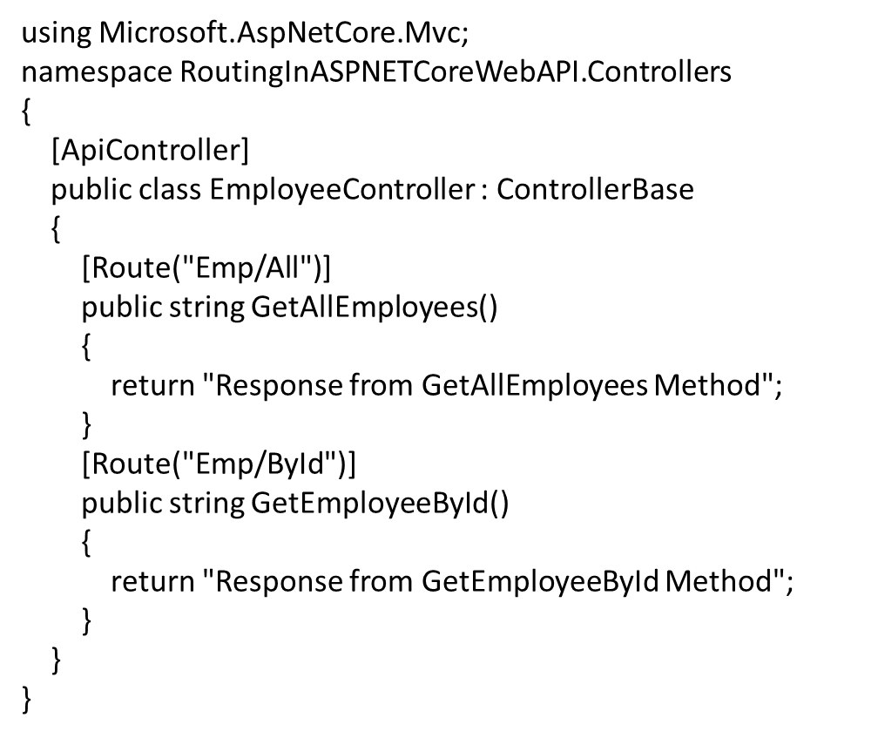

Slide 10
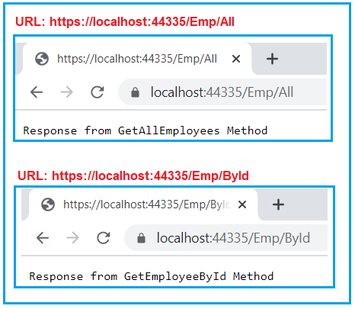

Slide 11
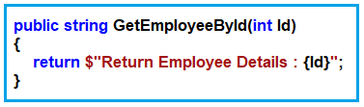
Working with Variables in ASP.NET Core Web API Routing:
When working with Real-time Restful services, then we need to deal with dynamic values like getting Order Details by Id, Get Employee details by Id, Get books by Author, etc. Let us see how we can handle the variables in the Routes in ASP.NET Core Web API Application.
For example, we have multiple employees and we want to fetch one employee detail by its Id. Then how we can get the Id values? The URL is the only place that is going to give us the Id value. So, we need to define one parameter to take the Id value within the method signature as shown in the below image
In ASP.NET Core Web Application, if you want to pass anything as a variable then you need to use curly braces {} and inside the curly braces, you need to give the name of the parameter your method accepting. In our example, the GetEmployeeById method takes the Id parameter, so we need to pass the Id within the curly braces of the Route attribute as shown in the below image.

Slide 12
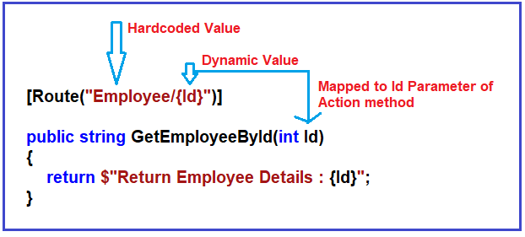

Slide 13
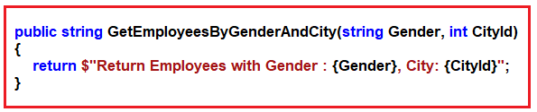
Passing Multiple dynamic Values in ASP.NET Core Web API Routing:
Now let us understand how to pass multiple dynamic values using the Route attribute. Now we need to fetch all the employees by Gender and City. Here, we want the Gender to be Male or Female i.e. as a string value and intentionally, we want to City Id value i.e. an integer value. So, we will create one action method which takes two parameters, one of which is Gender, and the order one is CityId as shown in the below image.

Slide 14
[Route("Employee/Gender/{Gender}/City/{CityId}")]
public string GetEmployeesByGenderAndCity(string Gender, int CityId)
{
return $"Return Employees with Gender : {Gender}, City: {CityId}";
}

Slide 15
How to pass Multiple Query Strings in ASP.NET Core Web API?
Let us understand how to pass multiple query strings with an example. In a real-time application, when you implement a search functionality, you generally accept multiple search parameters to filter out the data, Let say, we want employee city, gender, and department to filter out the number of employees to be returned. Then, in that case, our action method accepting three parameters. So, modify the SearchEmployees method of the Employee Controller class as shown below.
[Route("Employee/Search")]
public string SearchEmployees(string Department, string Gender, string City)
{
return $"Return Employees with Department : {Department}, Gender : {Gender}, City : {City}";
}

Slide 16
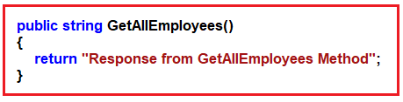
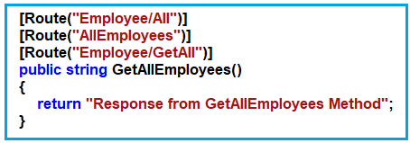
Multiple URLs for a Single Resource using Routing
Now we want to access the above resource with three different URLs such as Employee/All, AllEmployees, Employee/GetAll, then how we can do this? If this is our requirement, then we need to decorate the GetAllEmployees action method with three different Route attributes as shown in the below image.

Slide 17
What are Tokens in ASP.NET Core Attribute Routing?
Token Replacement is a new feature available in ASP.NET Core and it was not available in .NET Frameworks like ASP.NET MVC and ASP.NET Web API. The meaning of token replacement is, we can replace the value of the controller and action method dynamically.
In ASP.NET Core Web API Application, the Route Attribute support token replacement. It means we can enclose the token (i.e. controller and action) within a pair of square braces ([]). The tokens (i.e. [controller] and [action]) are then replaced with the values of controller and action method name where the route is defined.

Slide 18
using Microsoft.AspNetCore.Mvc;
namespace RoutingInASPNETCoreWebAPI.Controllers
{
[ApiController]
[Route("[controller]")]
public class EmployeeController : ControllerBase
{
[Route("[action]")]
public string GetAllEmployees()
{
return "Response from GetAllEmployees Method";
}
[Route("[action]")]
public string GetAllDepartment()
{
return "Response from GetAllDepartment Method";
}
}
}

Slide 19
using Microsoft.AspNetCore.Mvc;
namespace RoutingInASPNETCoreWebAPI.Controllers
{
[ApiController]
[Route("[controller]/[action]")]
public class EmployeeController : ControllerBase
{
public string GetAllEmployees()
{
return "Response from GetAllEmployees Method";
}
public string GetAllDepartment()
{
return "Response from GetAllDepartment Method";
}
}
}

Slide 20
How to override the Controller level Route Attribute at the action method level?
In ASP.NET Core Application, you can override the Controller level Route Attribute at the action method level by using the ~ (tilde) symbol. So, modify the GetAllDepartment action method as shown below to use the tilde symbol to override the route defined at the employee controller.
[Route("~/department/all")]
public string GetAllDepartment()
{
return "Response from GetAllDepartment Method";
}

Slide 21
Route Constraints in ASP.NET Core Web API
Type: int, double, bool, float, datetime, etc
Min: min(number)
Max: max(number)
Range: range(10. 15)
Alpha: alpha
MinLength: minlength(5)
MaxLength: maxlength(10)
Length: length(10)
Required: required
Regex: regex(expression)
The Route Constraints in ASP.NET Core Web API Attribute Routing are nothing but a set of rules that can be applied to routing parameters to restrict how the parameters in the route template are matched. The syntax to use Route Constraints is: {parameter:constraint}

Slide 22
Alpha constraint in ASP.NET Core Web API:
If you want any parameter to accept only alphabets (a to z characters) values then you need to specify the alpha constraint. So, let us decorate the GetEmployeeDetails method which takes string parameters with the following Route Attribute.
[Route(“{EmployeeName:alpha}”)]
Here, alpha stands for uppercase or lowercase alphabet characters. So, changes the GetEmployeeDetails method which takes the string parameter as shown below.
[Route("{EmployeeName:alpha}")]
public string GetEmployeeDetails(string EmployeeName)
{
return $"Response from GetEmployeeDetails Method, EmployeeName : {EmployeeName}";
}

Slide 23
Max(Number) constraint in ASP.NET Core Web API:
Along with the min constraint, you can also specify the max constraint in ASP.NET Core Web API. The max constraint also takes one parameter which is used to specify the max value that can be applied to the parameter. For example, if you want the EmployeeId in the URL should not to be greater than 1000, then you can use the max constraint as shown below.
[Route("{EmployeeId:int:max(1000)}")]
public string GetEmployeeDetails(int EmployeeId)
{
return $"Response from GetEmployeeDetails Method, EmployeeId : {EmployeeId}";

Slide 24
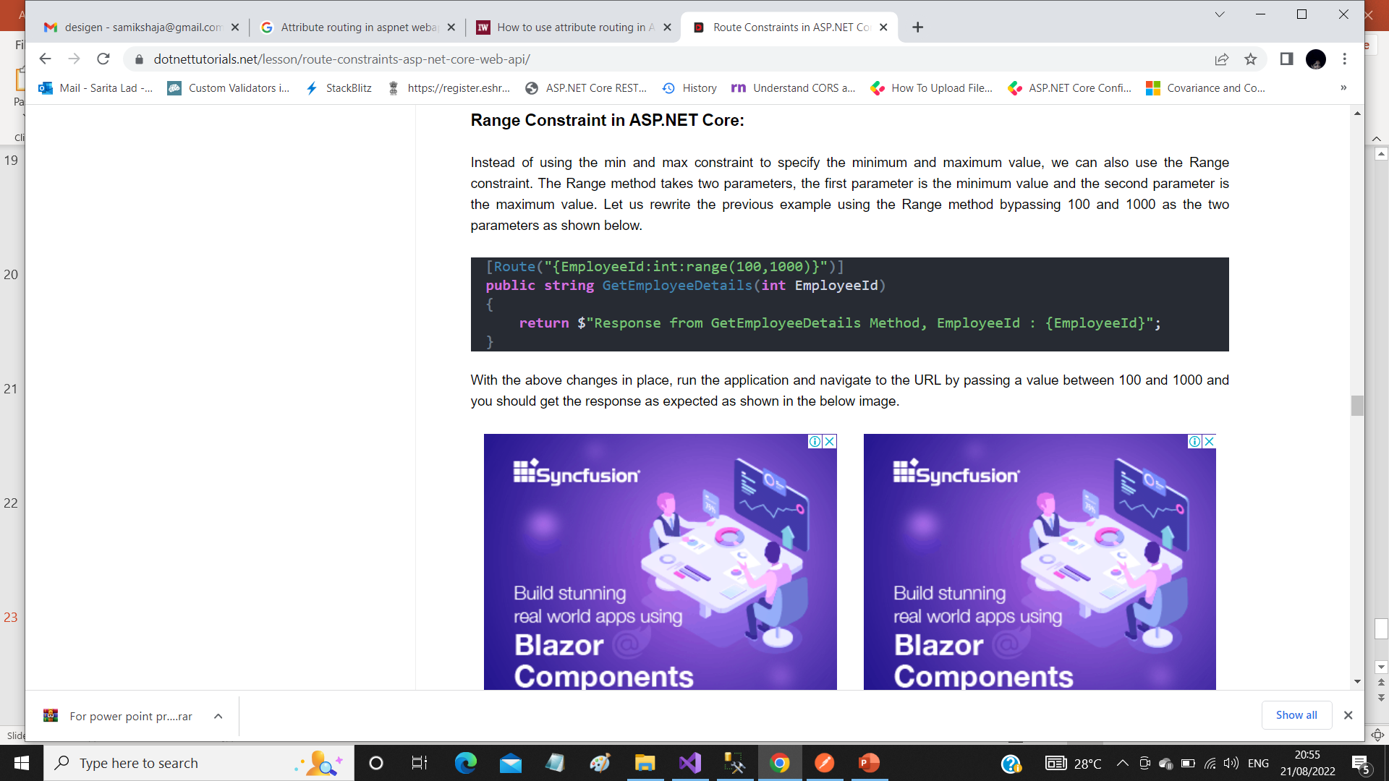

Slide 25
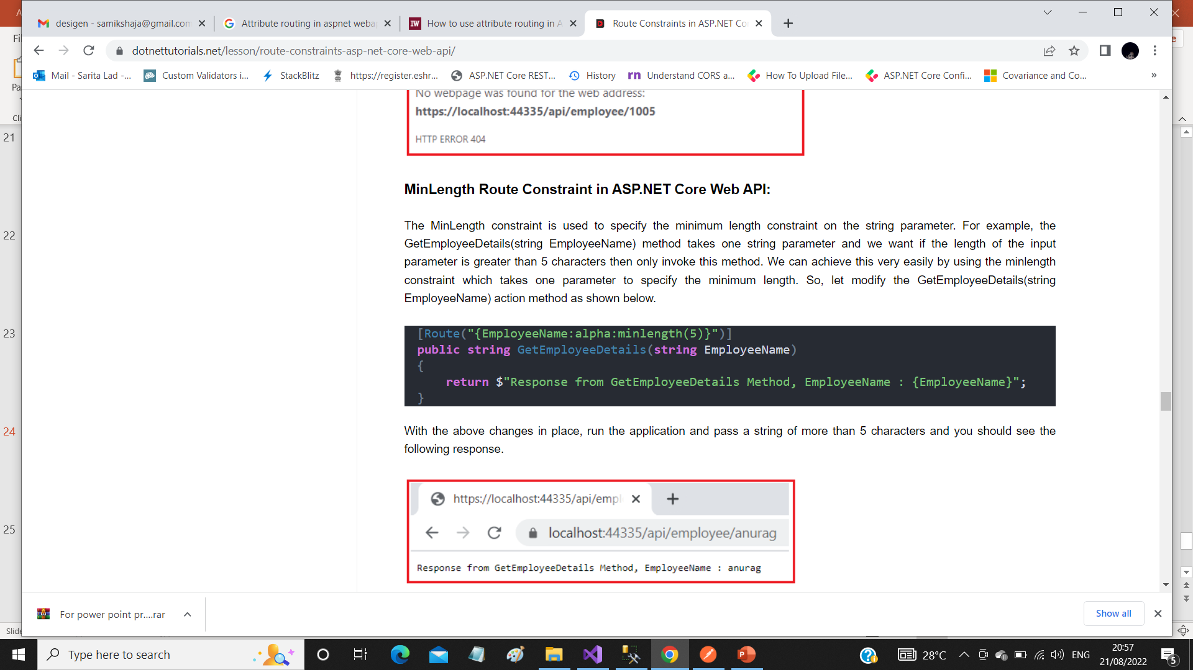

Slide 26
Thank You

